Slide 1
Diamond Price Prediction
Machine Learning project
Diamond, a mineral composed of pure carbon. It is the hardest naturally occurring substance known; it is also the most popular gemstone. Because of their extreme hardness, diamonds have a number of important industrial applications.
about 250 tons of gravel are needed to extract only one carat of diamond? And that 80% of the diamonds mined are used for industrial purposes.

Slide 2
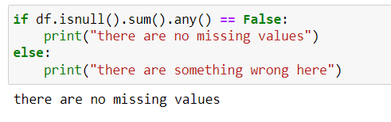
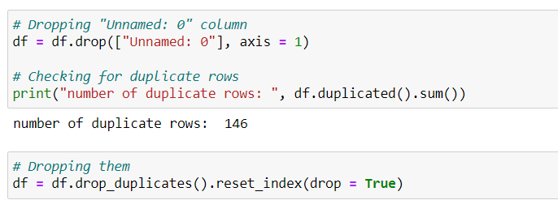
I’ve downloaded this data from Kaggle problem statement :- prediction of Dimond price with help of given features (carat, cut, clearity, depth, table) with the help of EDA(Exploratory Data Analysis) we will be able to get the insights of the data and then we can start building and preparing the data for model building.
As you can see that there is no missing values in data, so we will check duplicated values
As we can see that there are some duplicate values in data and we can now delete them
And also we dropped a column unnamed which holds no value to us.

Slide 3
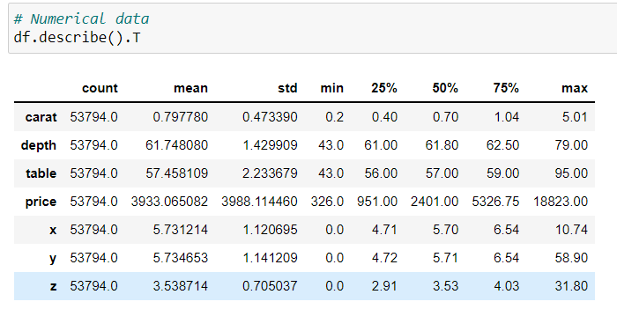
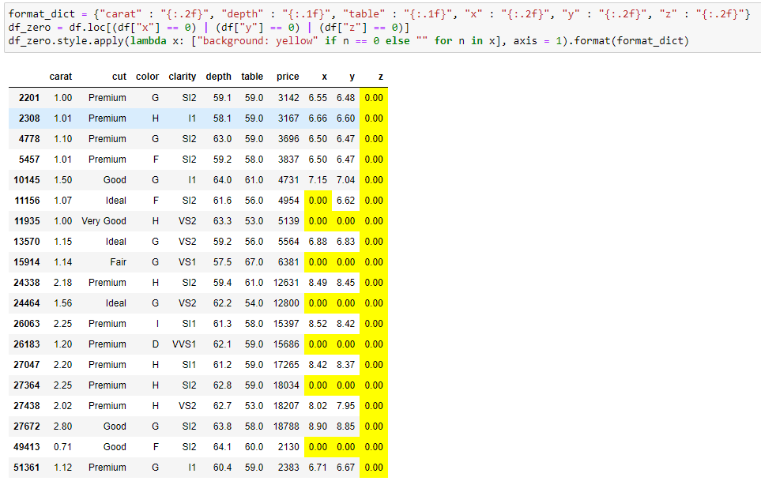
Using (describe) to get the statistical summary of the data to get the better insights of the column
After describing we can see that the minimum value of x, y and z features are equal to zero
We will take a look at them
We can see that values which are zero are actually missing values
So we will treat them as missing values

Slide 4
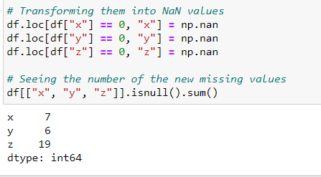
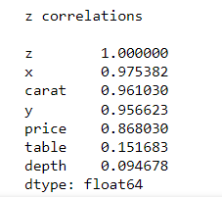
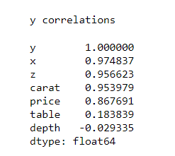
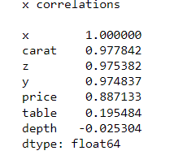
so we are transforming them as NaN values and then
We can see the missing values in the data
And we will check the correlation for these 3 columns
Now we can see that
x strongest correlation is with carat
y strongest correlation is with x
z strongest correlation is with x.
Since carat has no missing values and has a strong correlation with x, y and z
we are going to use the median of this correlation to fill them.

Slide 5
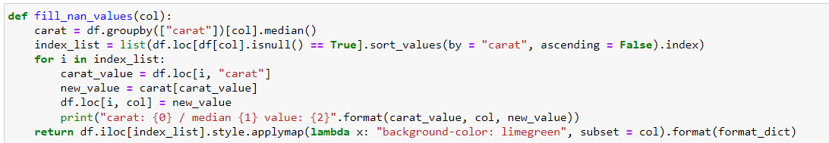
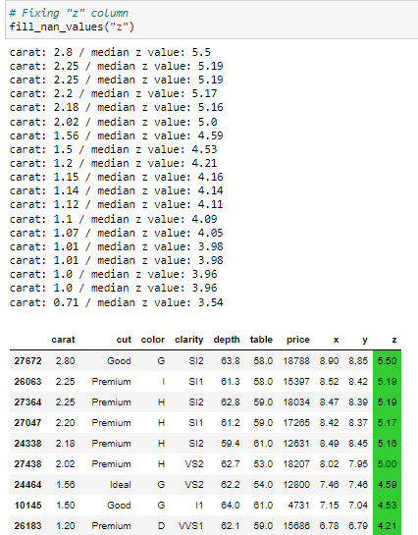
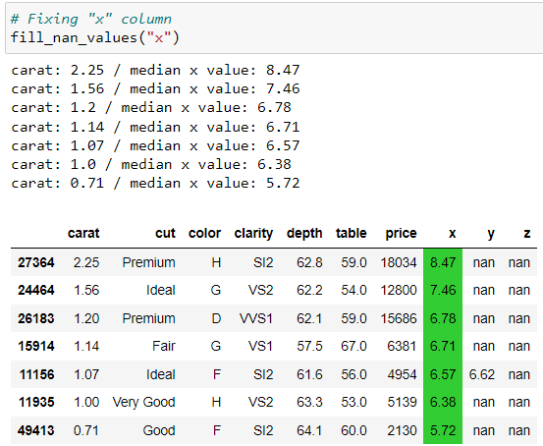
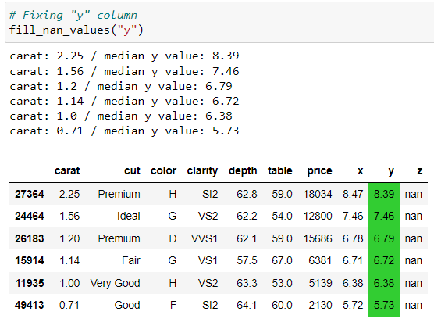
Defined a function to fill null values in x, y and z
Green highlighted values are the values which are filled with median

Slide 6
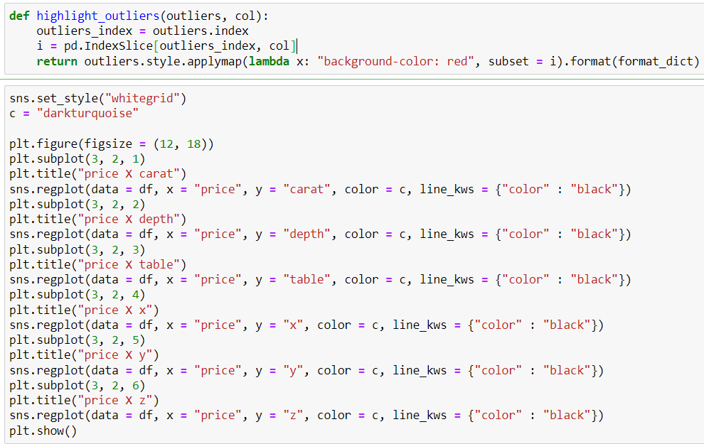
FINDING OUTLIERS
There are a lot of methods to find outlier values, but here we are going to use the simplest one: manually visualizing them. To this, we need to plot graphs showing the relation between all numerical features and the target (price).

Slide 7
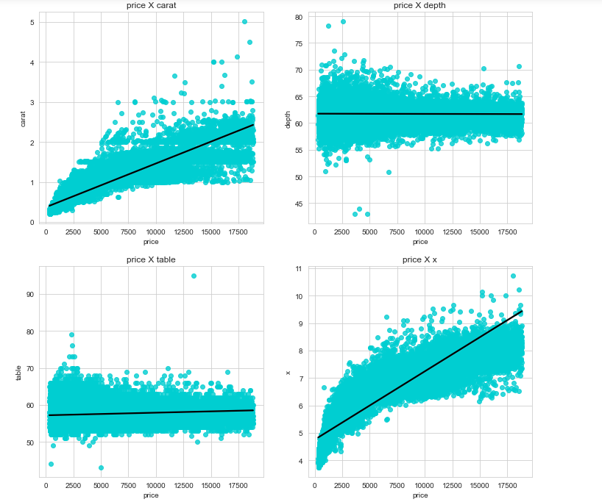
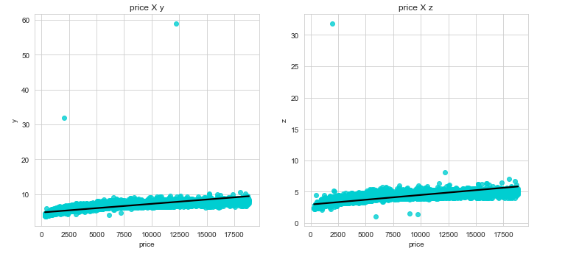
By looking at this we can see that there are outliers in the data
Three values are far from the others
Compare first graphs with the last one
So we will take a look at the values

Slide 8
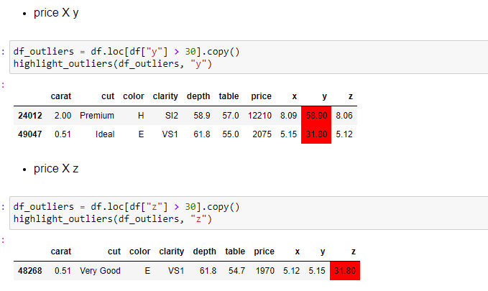
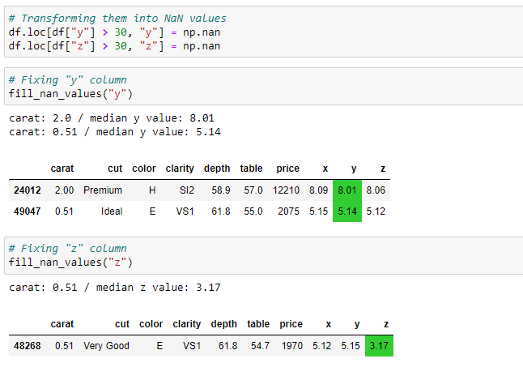
These red highlighted values are true outliers and we will treat them as we did with NaN values
So fixing them and replacing them with NaN values
And filling values in them
Now there are no outliers in x and z
And we have done same with other X depth,
X table and z

Slide 9
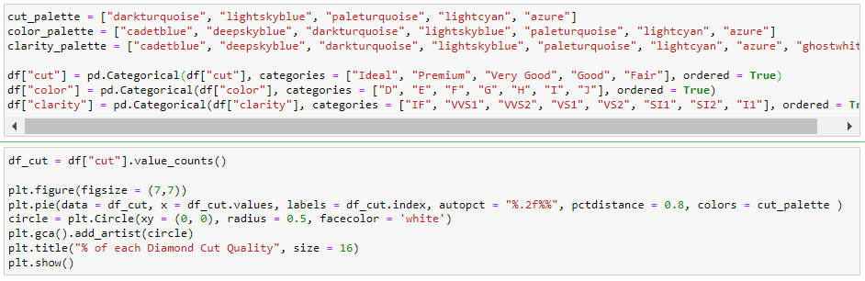
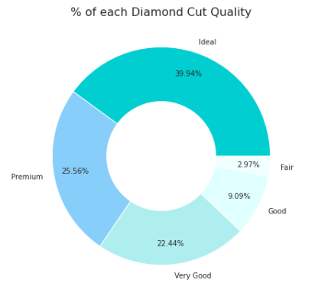
VISUALIZING DATA
Data visualization is the practice of translating information into a visual context, such as a map or graph, to make data easier for the human brain to understand and pull insights from. The main goal of data visualization is to make it easier to identify patterns, trends and outliers in large data sets.
So we can see that the majority of diamond cut are ideal
Order for the cut quality is as follows
1.Ideal
2.Premium
3.Very good
4. Good
5. Fair

Slide 10
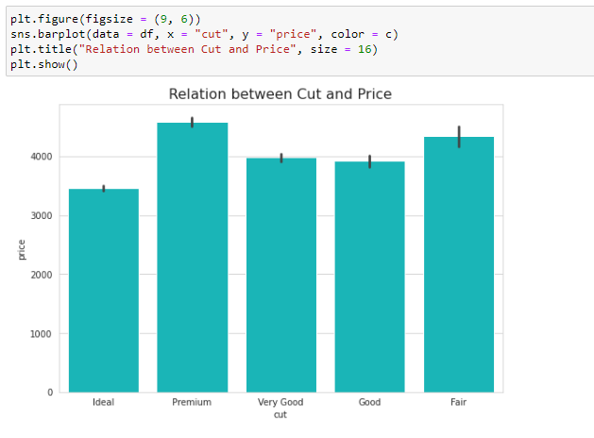
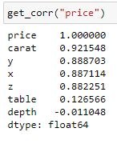
As we saw that quantity of high quality diamond is more so we will see how this will affect price by plotting relation between cut and price
Now we can see that the mean price of diamonds with ideal cuts are lower than all other diamonds with less quality cut
Finding the reason for this
By looking at correlation we can see that carat is highly correlated.
so carat is most important thing

Slide 11
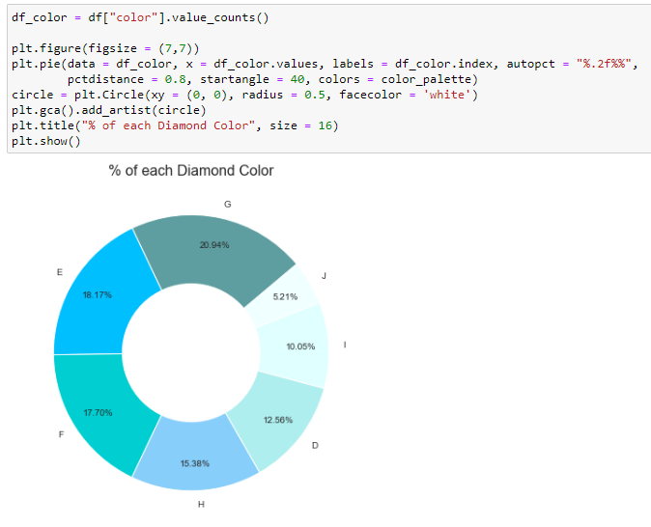
Here we’re checking the percentage of each colour of diamond in data
Order of the colour is as follows
D > E > F > G > H > I > J

Slide 12
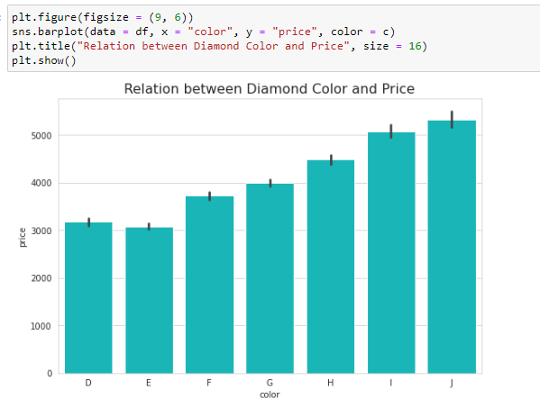
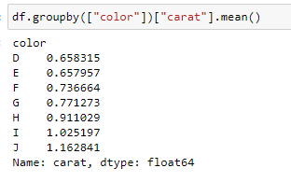
Here we will check the relation between diamond colour and price
So mean price of diamonds with better colour Is less than other colours
We will check the mean or colour and carat
As we can see that reason is same as the cut

Slide 13
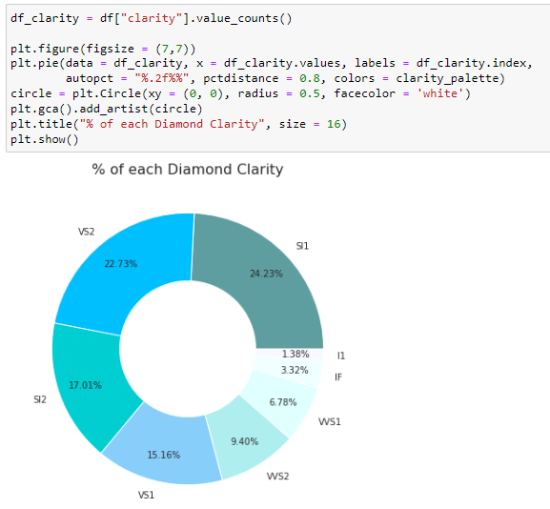
Now we will try to find the percentage of each diamond with clerity
As we can see that most number of clarity is of SI1
The order of the clarity is as follows
1.IF
2.VVS1
3.VVS2
4.VS1
5.VS2
6.SI1
7.SI2
8.I1

Slide 14
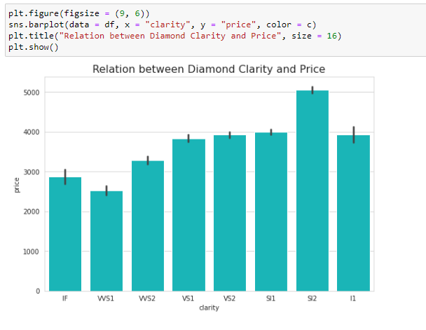
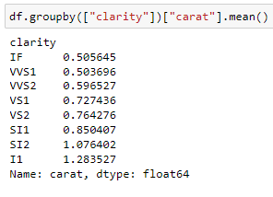
Now we will check the relation between diamond and price
Here also we can see that the average price of SI2 is more than IF
We will check the reason
And the reason is same as previous
Carat holds most important role in the price of the diamond

Slide 15



DATA PREPARATION
splitting data into x and y ( features and target
we will create two different algorithms because some will work better with dummy variables and others will work with label encoding
Scaling the data
In data preparation many steps takes place depending on the model which we are going create
Many steps are there like
Splitting the data into features and target
Creating dummy variables
Scaling data
Label encoding
Cross validation and evaluation the cross validation

Slide 16
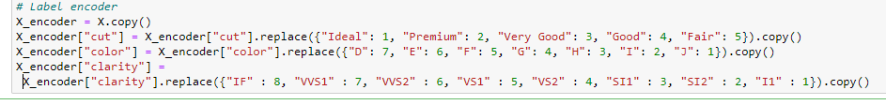

Label encoding the data for further model preparation
Cross validation :- is a technique for evaluating ML models by training several ML models on subsets of the available input data and evaluating them on the complementary subset of the data.
There are several types of cross-validation as follows
Ex: Holdout, K-fold, Stratified k-fold, Rolling, Monte Carlo, Leave-p-out, and Leave-one-out method
we will use k fold cross validation here

Slide 17
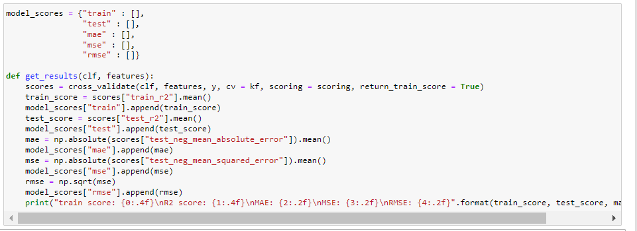
Defining function to get scores of different models as
Train
Test
MAE(mean absolute error)
MSE(mean squared error)
RMSE(root mean squared error)

Slide 18
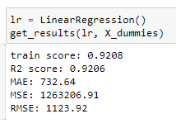
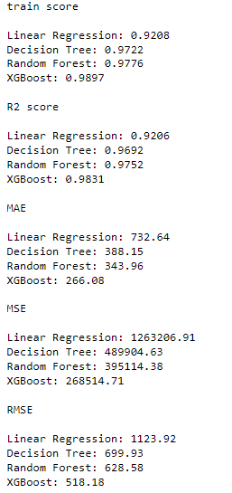
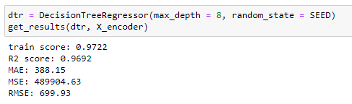
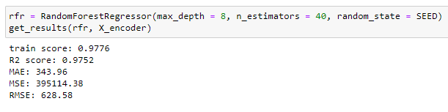
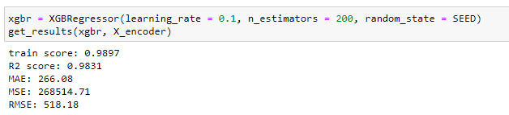
Building following models
Linear Regression
Decision Tree
Random forest
XG Boost
Printing scores
Linear regression
Decision tree
Random forest
XG Boost

Slide 19
Use for business
Diamonds have a set international market price, unlike other gems. In this respect, diamond is somewhat like gold. However, diamond pricing is much more complicated than gold. While every ounce of gold is the same, diamonds must be graded to determine their value. Even though the 4 C’s is the basic standard for grading, a myriad other factors influence diamond value.
Diamonds used to go through the hands of several intermediaries (as many as eight) from mine to wholesale to retail. Each of them took a cut before the diamonds reached retail. The retailers then sold the diamonds for whatever price they pleased.
With the help of this machine learning model its so easy and accurate to predict the price of diamond and it can save much more amount of money and time.
This is more accurate than a normal jeweller checking and evaluating price of that diamond
Thank you!

